Slide 1


ENHANCING AND OPTIMIZING ASSET AND EQUIPMENT LIFECYCLE MANAGEMENT THROUGH PREDICTIVE MAINTENANCE TECHNIQUES
Presenter: Oluwatosin Ayokunle Ojo
Supervisor: Ibtisam Mogul
Course: M.Sc. Data Analytics and Technologies
Institution: University of Bolton
Date: September 2024

Slide 2

Table of Content
Introduction
Background
Problem Statement
Significance of Research
Aims and Objectives
Research Questions
Literature Review
Methodology

Slide 3

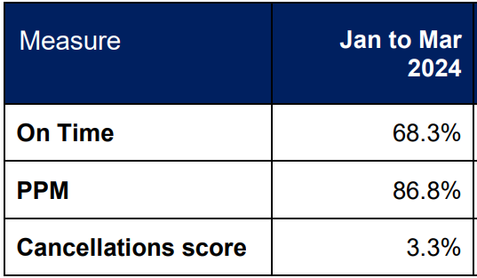


Introduction
Organizations like data centres, metro rail companies, and hospitals struggle with traditional, reactive maintenance approaches.
These approaches lead to prolonged downtimes, increased operational costs, and inefficient resource allocation as shown in the figure.
Many organizations face difficulties integrating and scaling predictive maintenance solutions due to issues like big data, system integration, and accuracy of predictive techniques.

Slide 4
Significance of Research
1. MINIMAL DOWNTIME:
2. INCREASED LIFESPAN:
3. RESOURCE ALLOCATION OPTIMIZATION:.
4. IMPROVED DECISION MAKING:

Slide 5

Aim and Objectives
Aim The aim of this report is to develop an Equipment Lifecycle Management System that integrates various machine learning and deep learning techniques to predicting failures and improve equipment maintenance.
Objectives
Organize a detailed literature review to analyze various technological advancements in big data, ML, and AI for improving lifecycle management.
Identify the issues and challenges about the utilization of big data and ML technologies in Equipment Lifecycle Management.
Design, develop, and implement a hybrid model system infusing different machine learning and deep learning techniques to improve the optimization of equipment lifecycle management.
Evaluate the performance of the models used, identify their merits and weaknesses, and suggest areas for future advancements or considerations.

Slide 6

Research Questions
What contemporary ML and DL techniques are prevalent in addressing Asset and Equipment Lifecycle Management via Predictive Maintenance Systems?
What equipment features and attributes of equipment are the most indicative for forecasting potential failures in Metro Railways?
How can predictive maintenance models be optimized using feature engineering, data sampling and feature selection to accurately forecast equipment failures?
Which ML or DL modelling technique is most effective for predicting equipment failures and what performance metric should be prioritized in evaluating models?
How will the implementation and integration of a predictive maintenance system benefit Metro Railways and other industries and what impact would it have on their decision-making process?

Slide 7
LITERATURE REVIEW
SOURCE | RELEVANCE | METHODOLOGY | DETAILS | STRENGHTS | WEAKNESS | IMPACT
(Li and Jung, 2023) | 4 | Experimental – LSTM and Autoencoders | LSTM and Autoencoders are used to identify abnormality of timepoints, intervals, and series | Structured comprehensive approach making use of diverse DL techniques used in addressing complex time-series data. | Interpreting the DL models such as LSTM and Autoencoders used, and its results can be complex. | Contribution to the field of anomaly detection.

Slide 8
LITERATURE REVIEW
SOURCE | RELEVANCE | METHODOLOGY | DETAILS | STRENGHTS | WEAKNESS | IMPACT
(Gupta, 2023) | 5 | Experimental - Autoencoders | Makes use of sparse and variational autoencoders on the digital and analogue sensor data. | Increase in performance levels of detecting anomalies and a reduction of false alarms. | Limits in exploring analogue dataset and comparing other models on the datasets involved. | Shows the importance of DL in predictions and detecting anomalies.

Slide 9
LITERATURE REVIEW
SOURCE | RELEVANCE | METHODOLOGY | DETAILS | STRENGHTS | WEAKNESS | IMPACT
(Alamr and Artoli, 2023) | 4 | Experimental – Transformers encoder | Transformer encoder anomaly detection using ECG5000 and MIT-BIH Arrhythmia datasets. | Outperforms other traditional models by achieving high levels of Accuracy, Precision and F1-score. | Lower performance on MIT-BIH Arrhythmia dataset. | Transformer models offer improved performance levels for detecting anomalies.
(Amram et al., 2021b) | 4 | Experimental – Logistic Regression, Random Fores, Decision Tree | Initiates various ML models and checks its performance in predicting failures. | Improves prediction accuracy which can be integrated into various systems. | Sole focus on decision tree technique. | Adopts a strategic and scalable solution to detecting failures using decision tree algorithms.

Slide 10
LITERATURE REVIEW
SOURCE | RELEVANCE | METHODOLOGY | DETAILS | STRENGHTS | WEAKNESS | IMPACT
(Achouch et al., 2022) | 3 | Review | Talks about a novel approach that makes use of asset management and smart maintenance practices that help in point of failure detection and support decision making process. | Novel approach that integrates different sensors and maintenance approaches used for different machineries | The research is still relatively new and has a lot of ground to cover and practical use is not that applicable yet. Generalized findings might not be applicable to all industries. | Offers a complete view into the predictive maintenance and decision-making process.

Slide 11
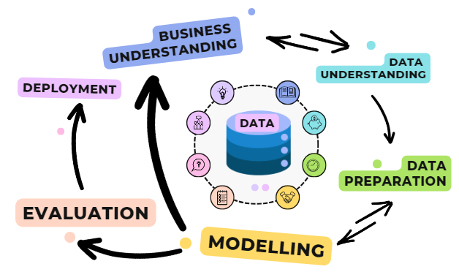
Research Philosophy
Research Philosophy adopted is the realism approach which is quantitative based in nature involving experiments
Tools:
Excel
R programming
Windows 10 Pro

Slide 12
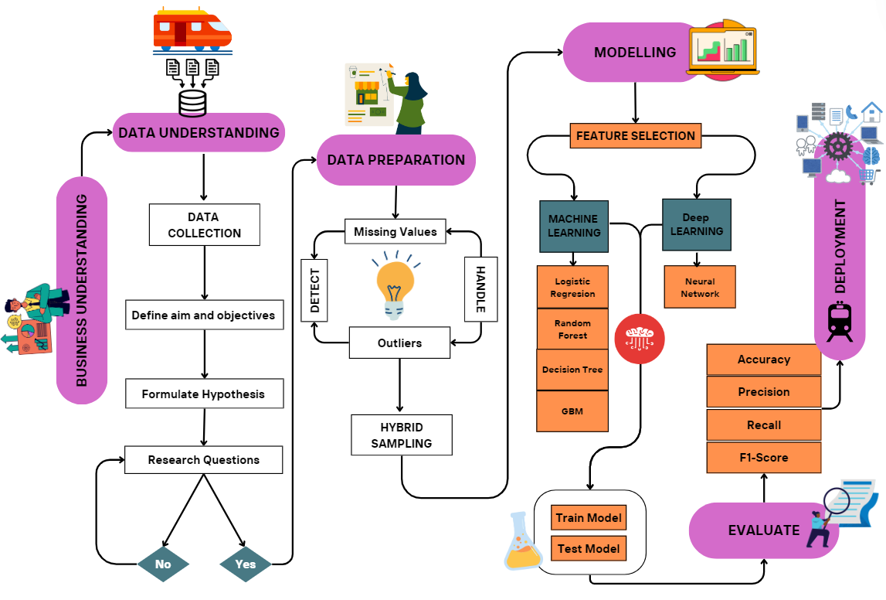
Research Methodology
MetroPT-3 Dataset
Metro
Railway
Station
80/20 Data split

Slide 13
Data Analysis Techniques
Data Pre-processing: Ensure data quality and data reliability.
Exploratory Data Analysis (EDA): Explore patterns, trends, and relationships between variables.
Over 1m rows and 16 columns
Data Sampling: Hybrid sampling approach to address class imbalance
Feature selection: Select most prevalent features.
Model Development:
80/20 split, Logistic Regression, Decision Tree, Random Forest, Gradient Boosting Machine, and Neural Networks.
Model Evaluation: Accuracy, Precision, Recall and F1-score

Slide 14
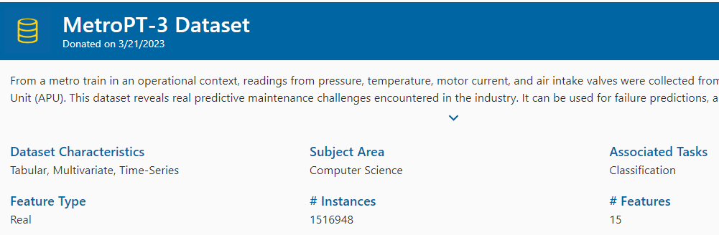
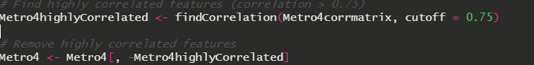
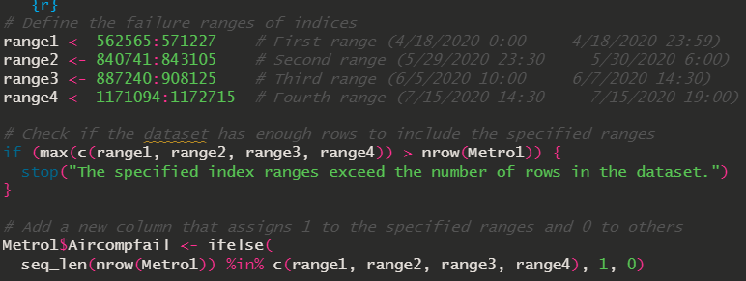
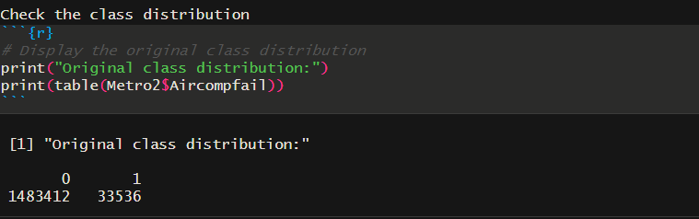

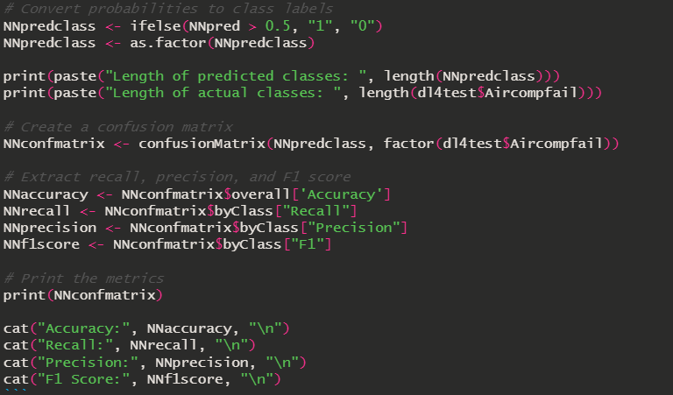
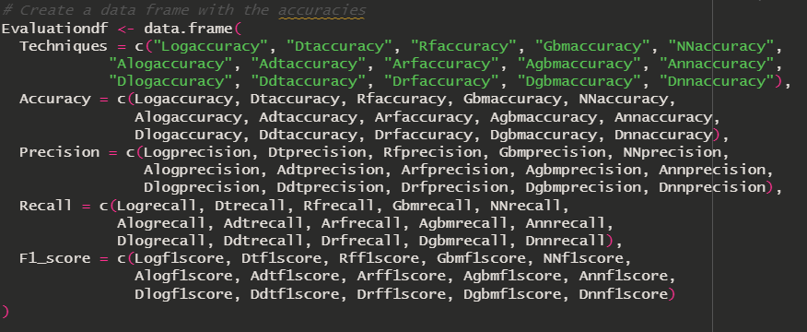
Implementation

Slide 15
Dataset Result Comparison
S/N | MODEL | MetroPT-3 Dataset |  | Analogue Sensor |  | Digital Sensor
 |  | Accuracy | F1-Score | Accuracy | F1-Score | Accuracy | F1-Score
1 | Logistic Regression | 0.9321386 | 0.9349089 | 0.9170735 | 0.9191520 | 0.7028913 | 0.7604012
2 | Decision Tree | 0.9283949 | 0.9308466 | 0.9304853 | 0.9341695 | 0.6955602 | 0.7555654
3 | Random Forest | 0.9435982 | 0.9462860 | 0.9887900 | 0.9888664 | 0.7028913 | 0.7604012
4 | GBM | 0.9338117 | 0.9366082 | 0.9343483 | 0.9375885 | 0.6955602 | 0.7555654
5 | Neural Network | 0.9380123 | 0.9409244 | 0.9372720 | 0.9401799 | 0.7028913 | 0.7604012
6 | Hybrid Model | N/A |  | 0.9393089 | 0.9422346 | N/A

Slide 16
Result Comparison – MetroPT-3 Dataset
S/N | DATASET | MODEL | ACCURACY | PRECISION | RECALL | F1-SCORE
MetroPT-3 (Metro4) Dataset
1 | Metro4 dataset | Logistic Regression | 0.9321386 | 0.8985375 | 0.9743491 | 0.9349089
2 | Metro4 dataset | Decision Tree | 0.9283949 | 0.9003325 | 0.9635016 | 0.9308466
3 | Metro4 dataset | Random Forest | 0.9435982 | 0.9035375 | 0.9932804 | 0.9462860
4 | Metro4 dataset | GBM | 0.9338117 | 0.8989365 | 0.9775755 | 0.9366082
5 | Metro4 dataset | Neural Network | 0.9380123 | 0.8989984 | 0.9869521 | 0.9409244

Slide 17
Result Comparison – Analogue Dataset
S/N | DATASET | MODEL | ACCURACY | PRECISION | RECALL | F1-SCORE
Analogue Dataset
6 | Analogue Dataset | Logistic Regression | 0.9170735 | 0.8969832 | 0.9424444 | 0.9191520
7 | Analogue Dataset | Decision Tree | 0.9304853 | 0.8874385 | 0.9860955 | 0.9341695
8 | Analogue dataset | Random Forest | 0.9887900 | 0.9825141 | 0.9953015 | 0.9888664
9 | Analogue Dataset | GBM | 0.9343483 | 0.8937816 | 0.9859109 | 0.9375885
10 | Analogue Dataset | Neural Network | 0.9372720 | 0.8988208 | 0.9855287 | 0.9401799
11 | Analogue Dataset | Hybrid Model | 0.9393089 | 0.9896012 | 0.8991952 | 0.9422346

Slide 18
Result Comparison – Digital Dataset
S/N | DATASET | MODEL | ACCURACY | PRECISION | RECALL | F1-SCORE
Digital Sensor Dataset
12 | Digital Dataset | Logistic Regression | 0.7028913 | 0.6372372 | 0.9425815 | 0.7604012
13 | Digital Dataset | Decision Tree | 0.6955602 | 0.6313136 | 0.9407113 | 0.7555654
14 | Digital Dataset | Random Forest | 0.7028913 | 0.6372372 | 0.9425815 | 0.7604012
15 | Digital Dataset | GBM | 0.6955602 | 0.6313136 | 0.9407113 | 0.7555654
16 | Digital Dataset | Neural Network | 0.7028913 | 0.6372372 | 0.9425815 | 0.7604012

Slide 19
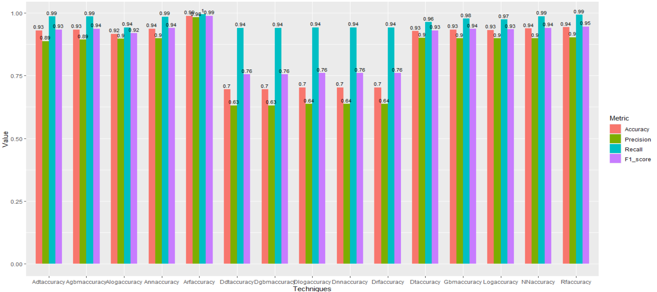
Results Overview

Slide 20
Prior Research Vs Major Contribution by this research
Prior Research
Major Contribution
Model comparison: LR, RF, DT, GBM,NN, and Hybrid (RF & NN).
Improved Accuracy score of 98.83%, Precision of 98.2%, Recall of 99.5% and F1-score of 98.9%
(Davari et al., 2021) uses Variational Autoencoders and Sparse Autoencoders with 45% and 34% F1-score.
(Nair et al., 2024) has Accuracy of 99.83, Precision of 98.2% and Recall of 98.7%.

Slide 21

Key Findings
Significant increase in the use of big data and machine learning for optimizing Asset and Equipment Lifecycle Management.
Predictive maintenance techniques like Random Forest, Decision Tree, Neural Networks, etc., improve operational efficiency and reduce downtime.
Best Dataset: The analogue dataset provided the most accurate predictions compared to the digital and entire MetroPT-3 datasets.
Best Performing Model: Random Forest achieved the highest and most consistent evaluation metrics across all models.
Hybrid Model Approach combines Random Forest and Neural Network with Accuracy – 93.9 % (Second best model)

Slide 22

Conclusions
Limitations:
Ethical concerns related to data privacy and security in predictive maintenance applications.
Lack of transparency, fairness, and model interpretability may impact model effectiveness and adoption.
Recommendations and Future Work:
Integrate diverse data sources to further enhance machine learning and deep learning models.
Explore more advanced deep learning techniques such as RNN, CNN, LSTM, and Autoencoders to handle complex datasets and improve prediction accuracy.

Slide 23

References
Achouch, M., Dimitrova, M., Ziane, K., Sattarpanah Karganroudi, S., Dhouib, R., Ibrahim, H. and Adda, M. (2022) ‘On Predictive Maintenance in Industry 4.0: Overview, Models, and Challenges.’ Applied Sciences. Multidisciplinary Digital Publishing Institute, 12(16) p. 8081.
Amram, M., Dunn, J., Toledano, J. J. and Zhuo, Y. D. (2021b) ‘Interpretable predictive maintenance for hard drives.’ Machine Learning with Applications, 5, September, p. 100042.
Davari, N., Veloso, B., Ribeiro, R. P., Pereira, P. M. and Gama, J. (2021) ‘Predictive maintenance based on anomaly detection using deep learning for air production unit in the railway industry.’ In 2021 IEEE 8th International Conference on Data Science and Advanced Analytics (DSAA). Porto, Portugal: IEEE, pp. 1–10.
Chauhan, S. and Vig, L. (2015) ‘Anomaly detection in ECG time signals via deep long short-term memory networks.’ In 2015 IEEE International Conference on Data Science and Advanced Analytics (DSAA). Campus des Cordeliers, Paris, France: IEEE, pp. 1–7.
Gupta, V. A. (2023) ‘Metro Rail — Predictive Maintenance Based On Anomaly Detection.’ Medium. 11th December. [Online] Available from: https://medium.com/@vgupta701/metro-rail-predictive-maintenance-based-on-anomaly-detection-0008ffa7a5b7 [Accessed on 6th September 2024].
Li, G. and Jung, J. J. (2023) ‘Deep learning for anomaly detection in multivariate time series: Approaches, applications, and challenges.’ Information Fusion, 91, March, pp. 93–102.
Alamr, A. and Artoli, A. (2023) ‘Unsupervised Transformer-Based Anomaly Detection in ECG Signals.’ Algorithms, 16(3) p. 152.

Slide 24

Thank You!
Questions?
Oluwatosin Ojo
Data Engineer
oao3crt@bolton.ac.uk

